Slide 1
Beam It!
A LiFi Enabled Product
Giannina Duran, Josh Sohan
Team 8

Slide 2
What is LiFi?
LiFI is a high-speed wireless communication technology that uses visible light to transmit data.
LiFi products utilize light spectrum to transmit data, similar to how WiFi transmits data with radio and microwave frequency spectrum.
LiFi uses lights (ordinary lights/lamps) or LEDs to transmit data.
Why is this important? Light spectrum is widely available in all locations, compared to radio frequency spectrum which is increasingly congested or unavailable.
Benefits: LiFi provides speeds around 10 times faster than currently achievable speeds in WiFi.

Slide 3
Beam It Subsystem
Our objective is to design and implement a “LiFi” device that can transmit data (text, video, images, etc). In our subsystem, we will transmit an audio signal over Li-fi.
The Beam It subsystem uses the following components:
PAM 8403 Amplifier board
9V Battery
Speaker
USB to TTL Converter
Solar Panel
LED
Resistance of 220 ohm
Aux Jack
Speaker

Slide 4
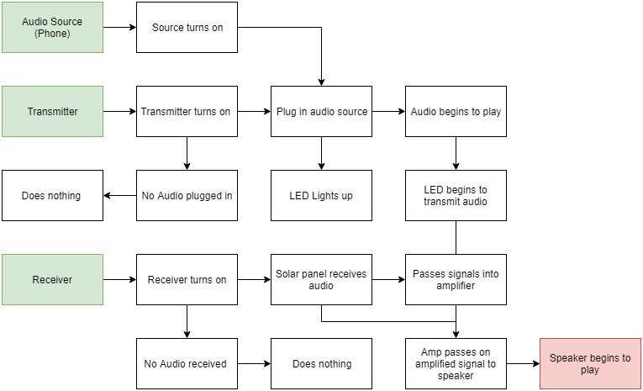
Beam It Subsystem Block Diagram

Slide 5
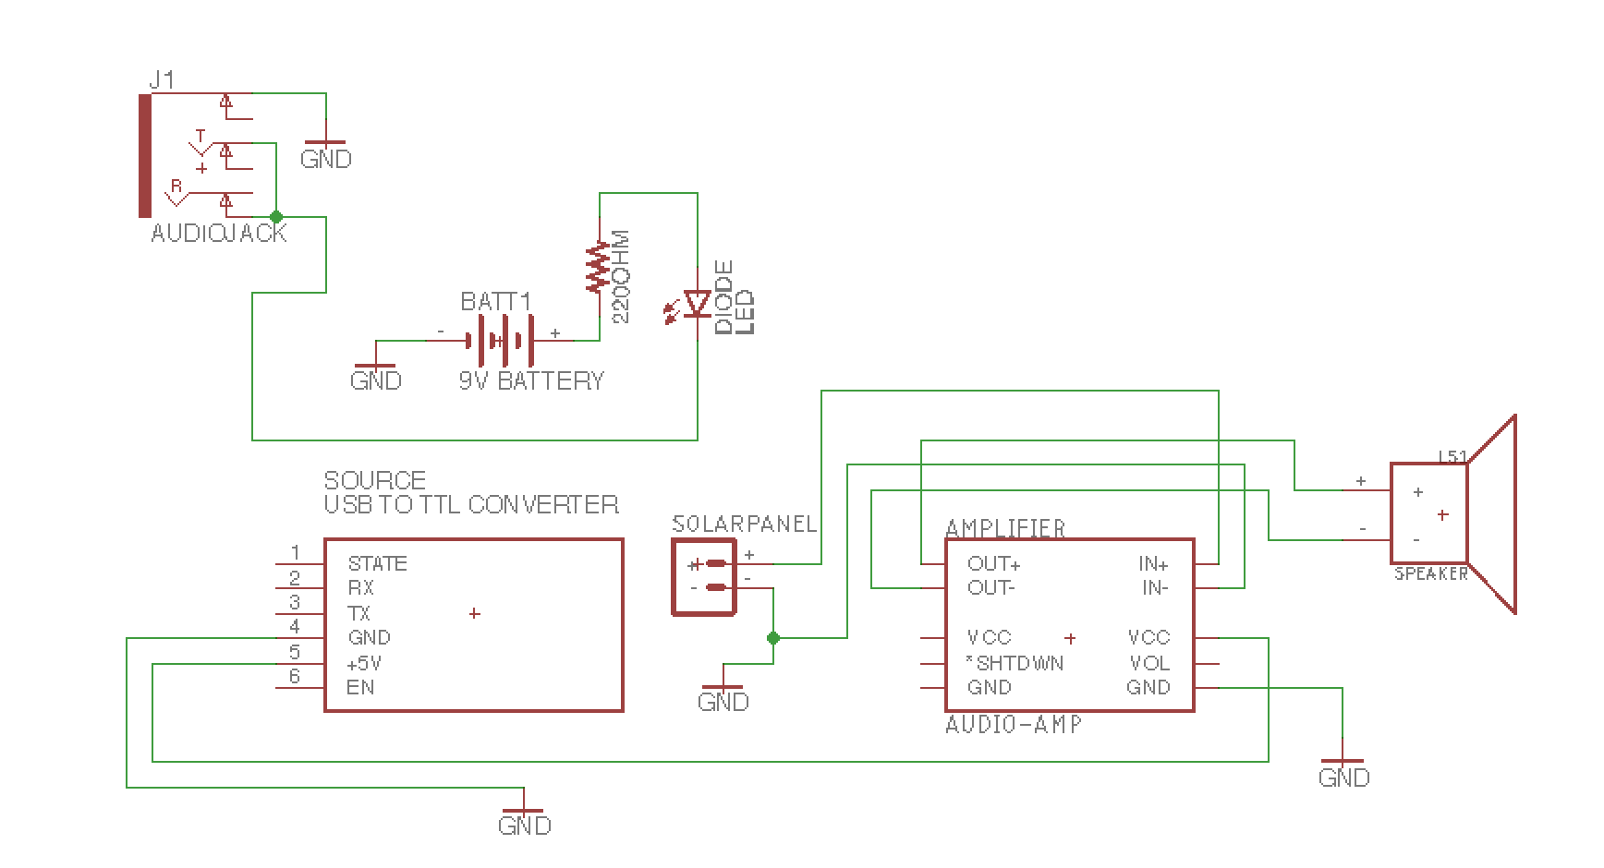
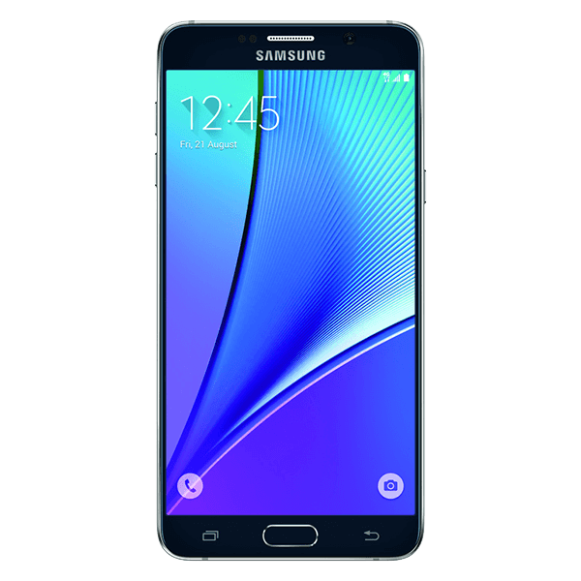
Beam It Subsystem Schematic

Slide 6
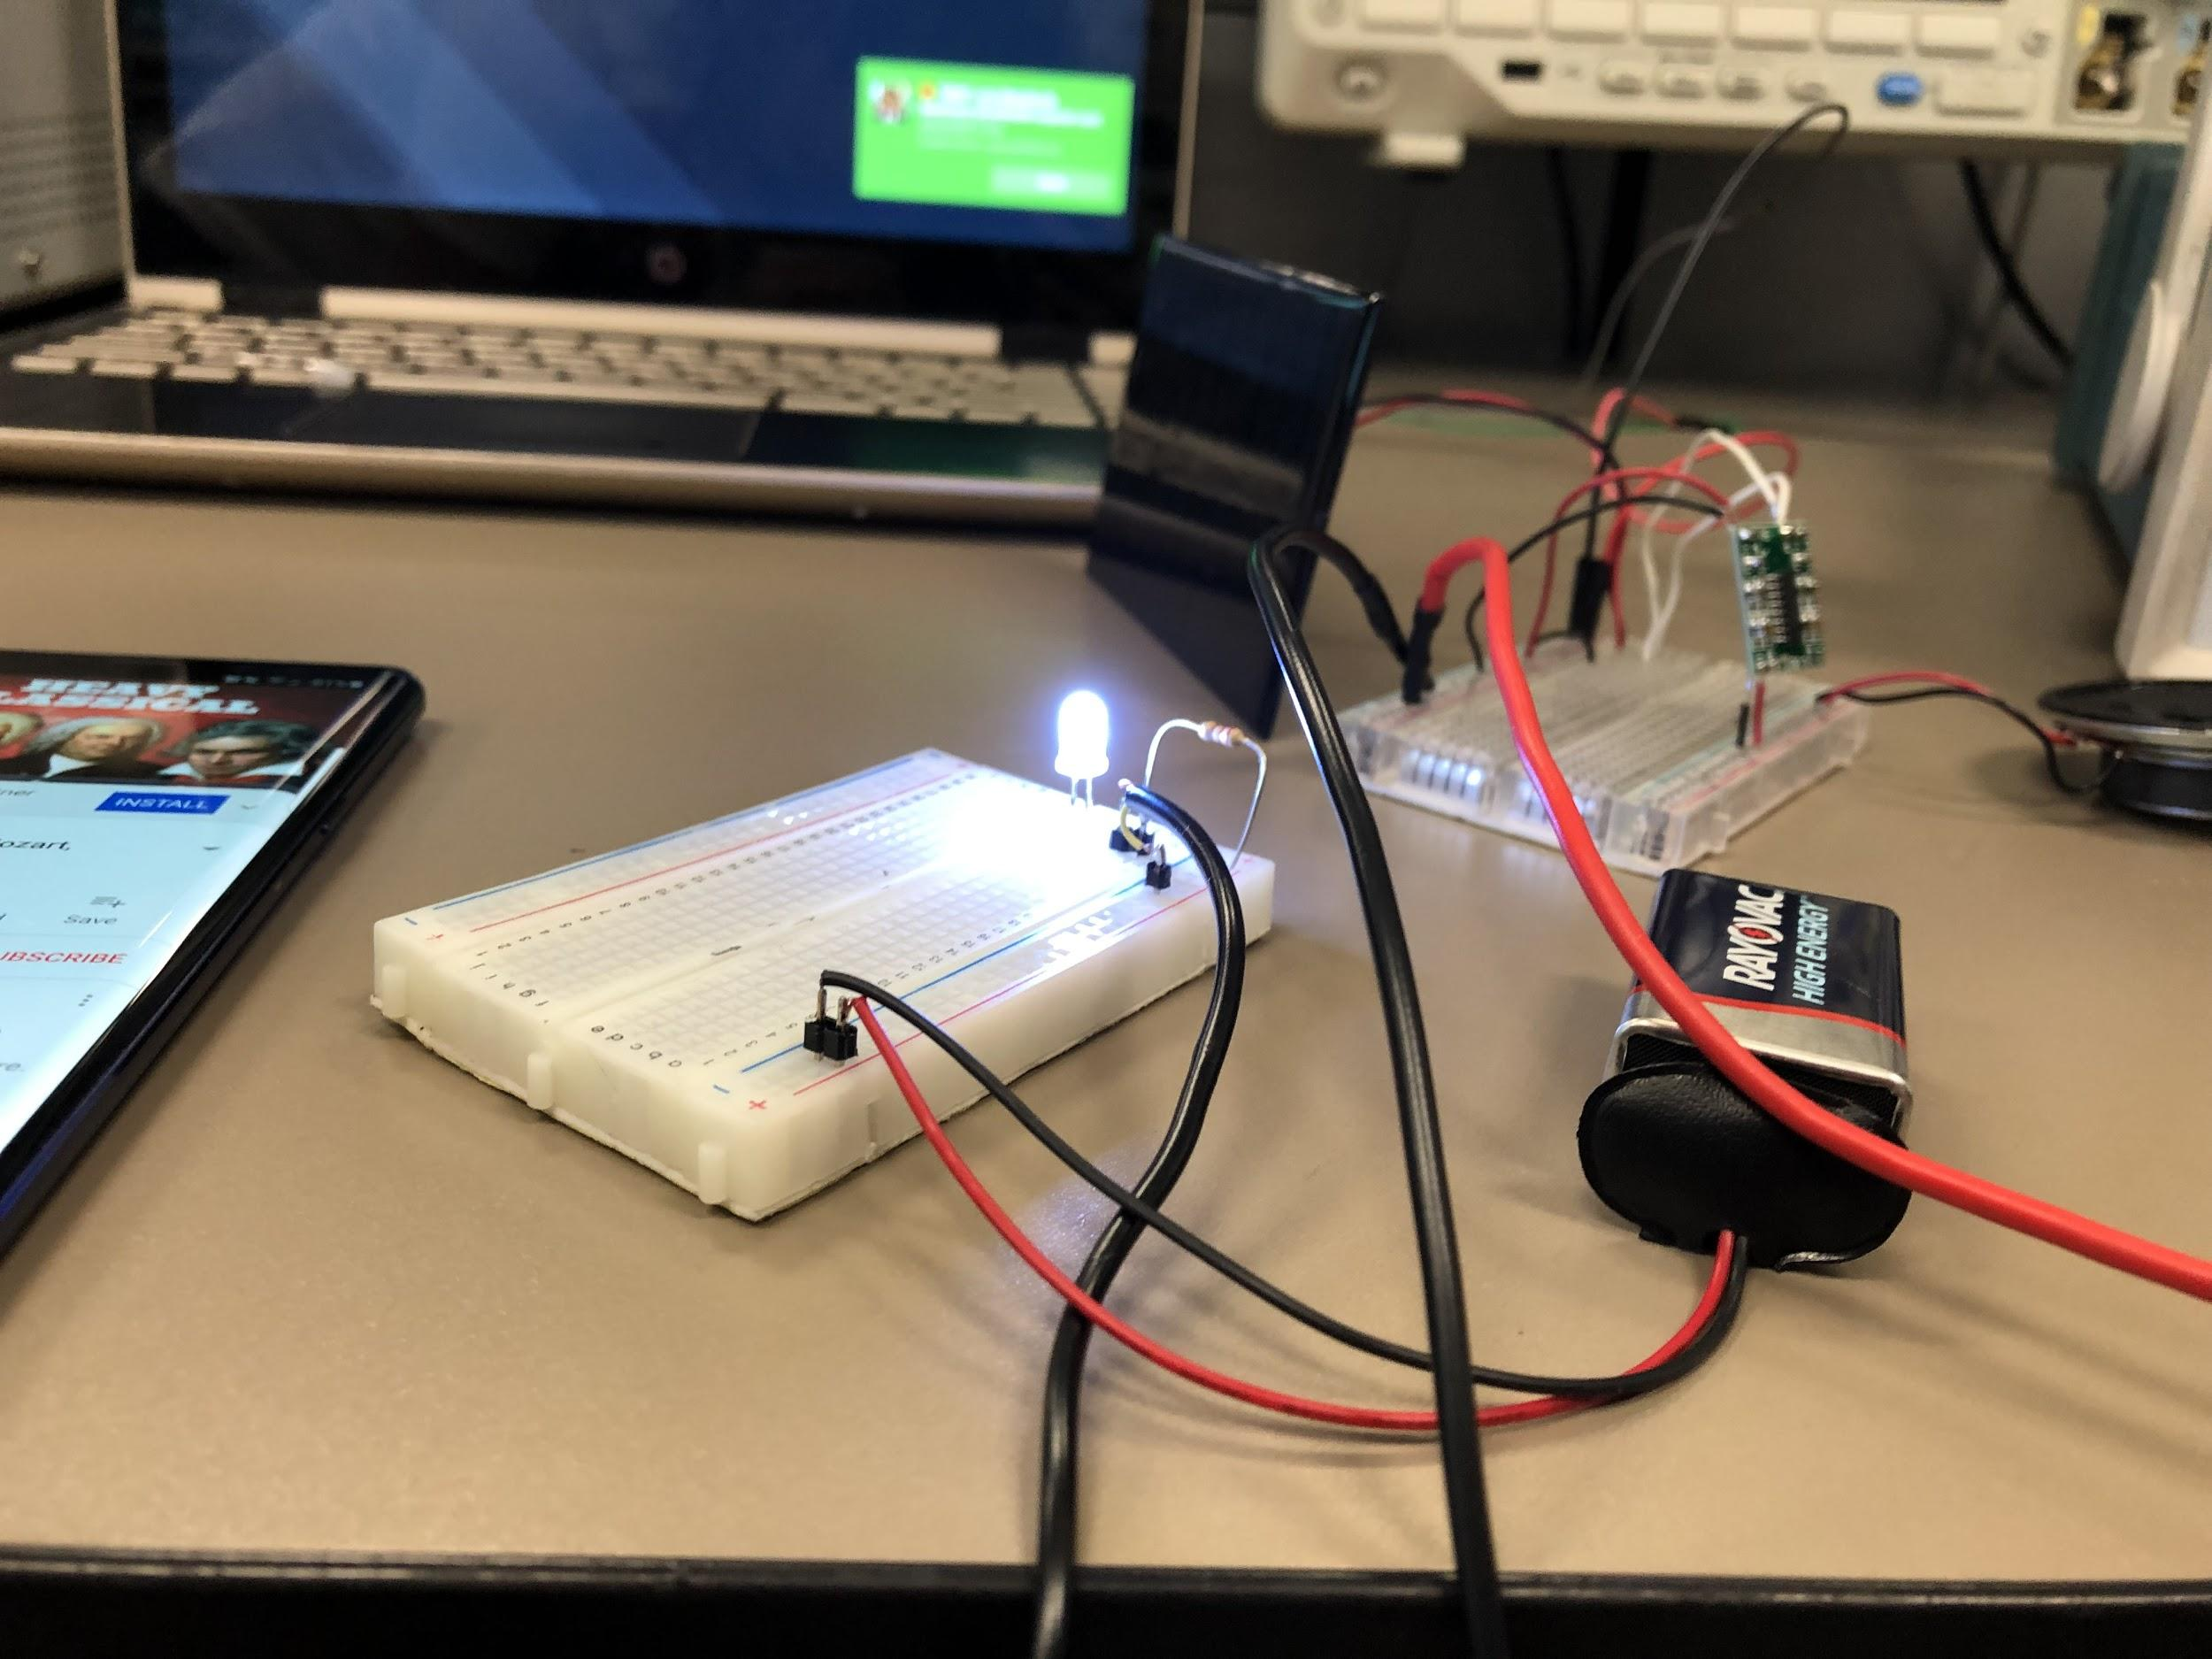
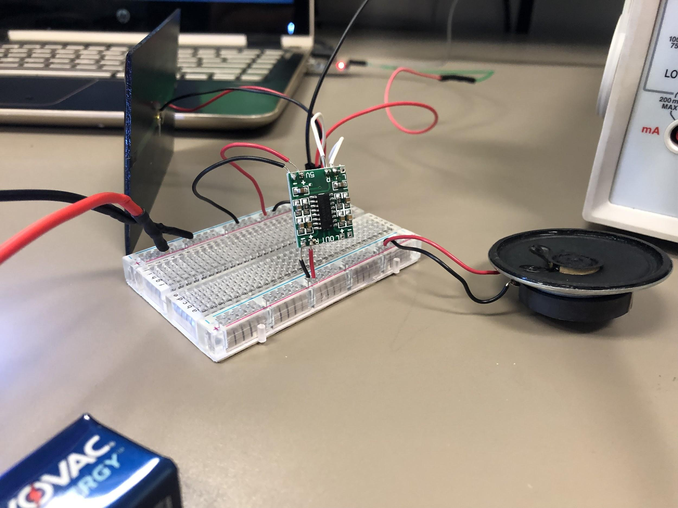
Beam It Subsystem

Slide 7
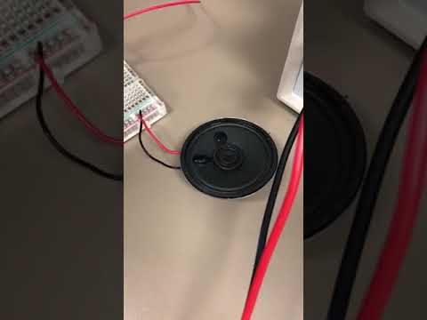
Beam It Subsystem Video Demo
Link: X

Slide 8
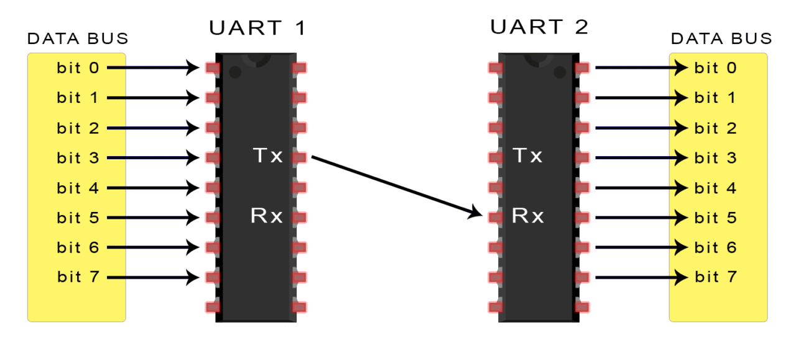
Data Packages
We will be using UART to transfer and save data now that we have an optimal way it receive it..
It is commonly used in devices such as CPUs or microcontrollers
Works by converting parallel data into serial data which is transferred and then converting it back into parallel data

Slide 9
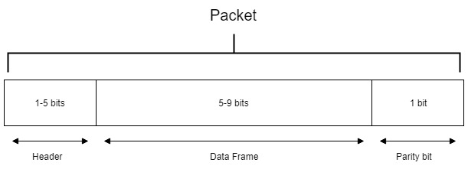
Data Packages
Header: Packet Number and/or device ID
Data Frame: Actual data being transferred
Parity: Uses the the number of 1s in the data frame to tell if the packet has been corrupted

Slide 10
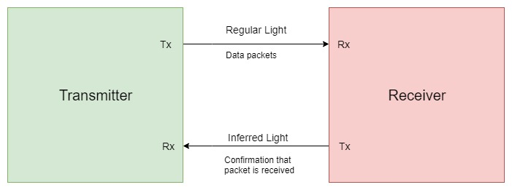
System Module Design
Our ultimate goal is to create one transmitter and multiple receivers that will receive different types of data and perform a task with it such as:
Music being played from a speaker
Text and images being displayed on a screen
Documents and larger file types being transferred and opened on a computer

Slide 11
QUESTIONS?
Notes:
Things to think about:
Do we make the receiver relay packet confirmation every one or multiple packets
Do we need to add a low pass filter to eliminate noise
How fast can we get the data rates up too
With final parts in, how far can we communicate

